Slide 1
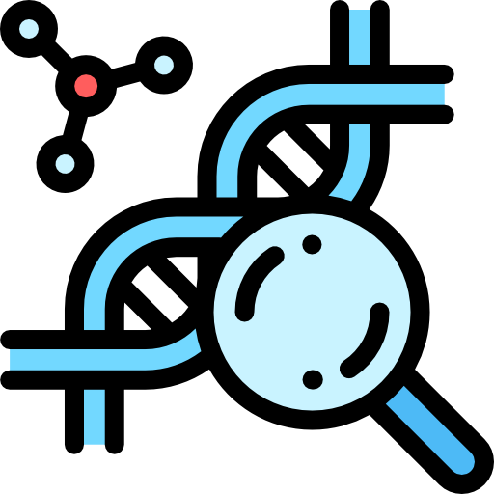
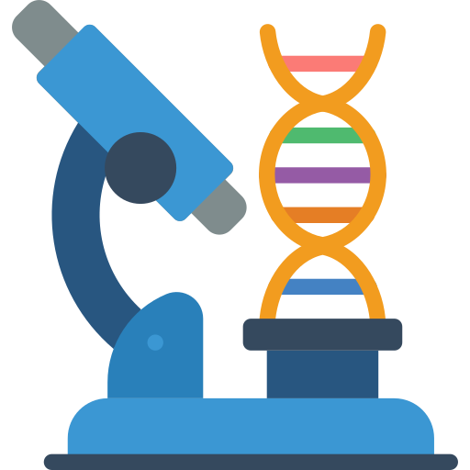


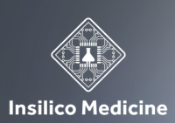


Global Longevity and Anti-Senescence Therapy Market Research Report 2021
CAGR
(2022-2030)
By Therapy:
5.83%
Largest Region: North America
By Therapy:
By Application:
Market Size:
US$ 25.33 Bn (2021)
Key Players:
2020
2030
US: +1 (718) 593 4405
Email: info@insightaceanalytic.com
INSIGHT ACE ANALYTIC

